Slide 1
r/soccer Analyzer
by Elias Hadgu

Slide 2
Purpose
Reddit can be an overwhelming source of information
The search function of Reddit has many flaws
The r/soccer Analyzer allows people who just want one thing (goals, news, etc...) easy access to it
The app also adds features that Reddit does not already have, such as specifically searching for comments and posts with good discussions

Slide 3
Usage

Slide 4
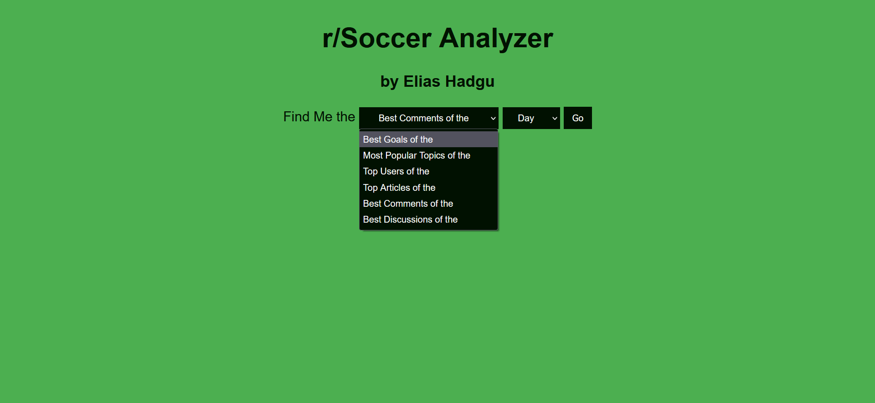

Slide 5
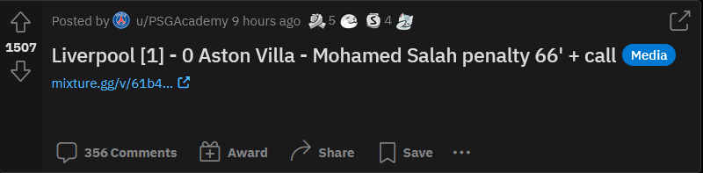
Goals
Allows the user to watch top goals with ease
Uses Okapi BM25 on post titles to search only for posts linking to goals
Older videos will be unavailable to view due to copyright
The query I chose to search for goals was "goal ' - [0] [1] [2] [3] [4] [5] [6] [7]"

Slide 6
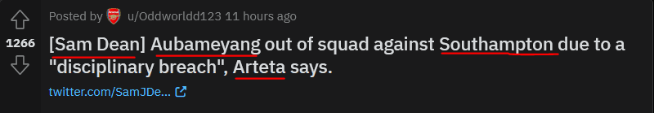
Most Popular Topics
Quick overview of hot topics in the subreddit
Topics can be teams or players and are identified as such using spacy’s NLP library
Popular is defined by the upvote count of the post the topic is in
I attempted to incorporate stemming so terms like “Liverpool” and “Liverpool FC” were identified as the same entity but I could not get it to work

Slide 7
Top Users
Creates a new way to keep track of the subreddit’s top contributors
Top users are users with the largest sum of upvotes during the given time period.
Includes a link to their profile if you want to see what they have posted. There is no profanity checker on usernames so beware!

Slide 8
News
Allows for quick access to top soccer news
Uses Okapi BM25 on post titles and urls
Title query: "FOX ESPN sky twitter athletic official"
URL query: "twitter news report daily athletic sky fox espn"
Many articles come from Twitter and news outlets like Sky Sports, ESPN, and the Athletic

Slide 9
Best Comments
Highlights comments that have high upvotes relative to the upvotes of the post it's responding to
This will take a while to run because looping through comments in PRAW takes a very long time
There is no profanity checker for comments so beware!

Slide 10
Getting Started

Slide 11
Discussions
Shows users posts with a large comments to post upvote ratio
Does not include match threads or discussion posts as this function is geared towards posts where discussion is not the main focus
If a reddit post includes a link to something else, it is not possible to get the link of the post on reddit through PRAW so some comments are not viewable from the app

Slide 12
Testing
Since all of the data is coming from r/soccer I would compare results of my app to the subreddit
Best goals: If any of the options were not goals
Popular topics: If any topics were not people, teams, or countries or if they included special characters
Users: If the user link didn’t work or I couldn’t see that user posting when I checked on reddit myself
News: If any of the options were not articles
Comments and Discussions: Checking if the displayed list was in order based off of the calculations to find them

